Slide 1
A comparison of automatic cell identification for single-cell RNA sequencing data
Ruidong Li
October 22, 2019

Slide 2
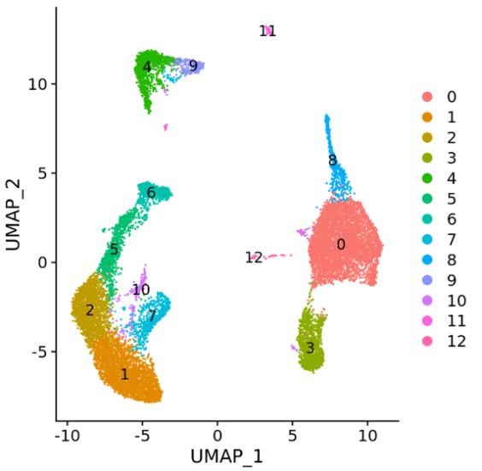
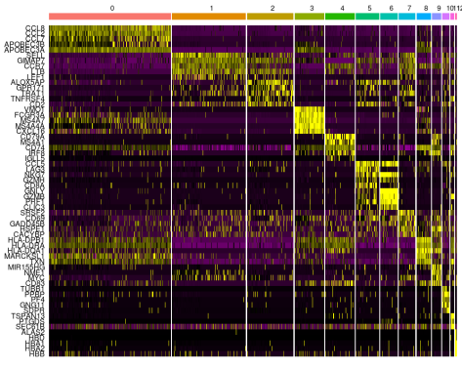
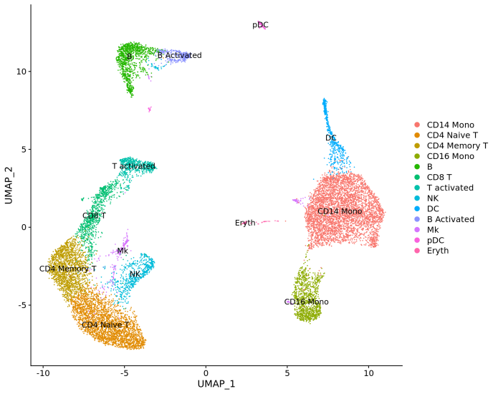
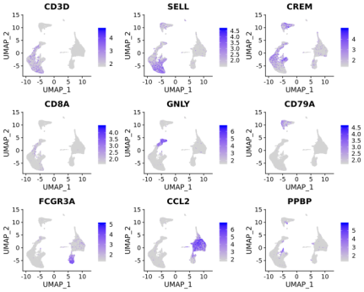
The traditional approach of constructing a cell atlas
Unsupervised clustering of the cells
Find differentially expressed features
(cluster biomarkers)
Assign cell type identity to clusters
Labor intensive, requiring extensive literature review of cluster-specific genes
Any revision to the analysis (for example, additional data, parameter adjustment) requires manual reevaluation of all previous annotations
Not reproducible across different experiments within and across research groups

Slide 3

Comprehensive evaluation of automatic cell annotation
22 automatic cell identification methods, including general-purpose classifiers
27 publicly available single-cell RNA sequencing datasets of different sizes, technologies, species, and levels of complexity
2 experimental setups: within dataset (intra-dataset) and across datasets (inter-dataset)
Evaluation metrics: accuracy (F1 score) and percentage of unclassified cells

Slide 4
Main conclusions
Most classifiers perform well across all the datasets
Classification performance depends on dataset complexity. All classifiers have an almost perfect performance for easy classification task, while it remains challenging for complex datasets with overlapping classes or deep annotations
The general-purpose support vector machine (SVM) classifier has overall the best performance across the different experiments
The performance of some classifiers may be underestimated. Tuning parameters of such classifiers may improve their performance, especially for the marker gene-based methods and reference-based methods

Slide 5
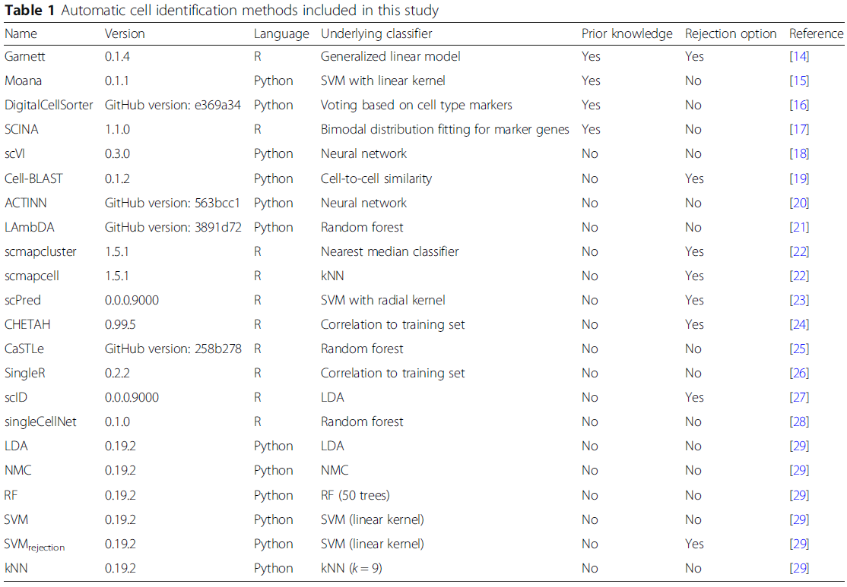
Overview of the automatic cell annotation methods
Nature Methods
bioRxiv
BMC Bioinformatics
Genes
Nature Methods
bioRxiv
Bioinformatics
Bioinformatics
Nature Methods
Nature Methods
bioRxiv
Nucleic Acids Research
PLoS One
Nature immunology
bioRxiv
Cell Systems

Slide 6

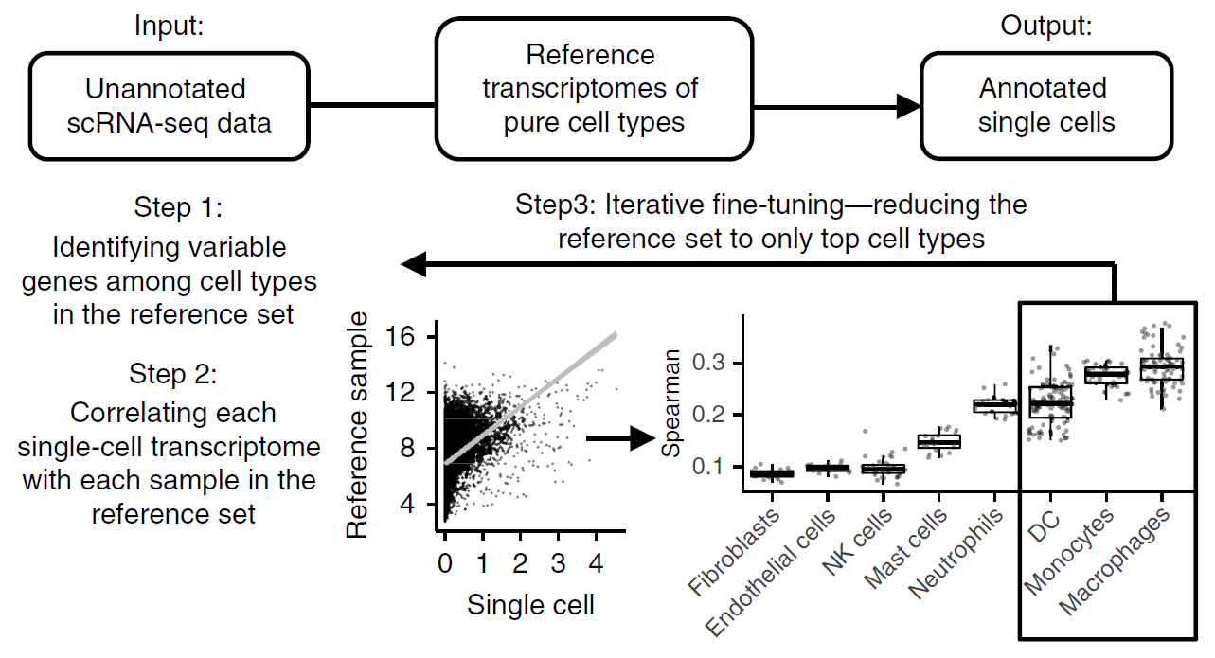
SingleR
The SingleR pipeline is based on correlating reference bulk transcriptomic data sets of pure cell types with single-cell gene expression
7 built-in reference sets of bulk RNAseq of pure cell types
User-provided single-cell references are also supported
Spearman coefficient

Slide 7
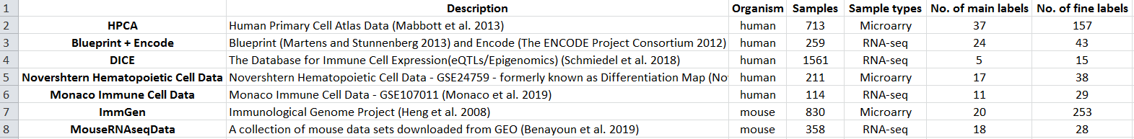

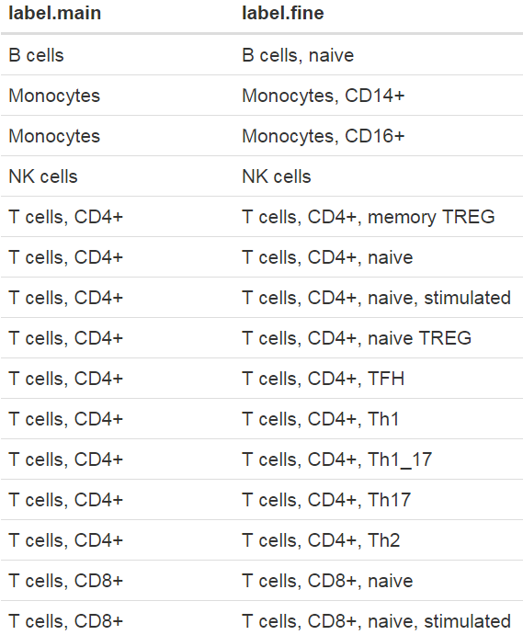
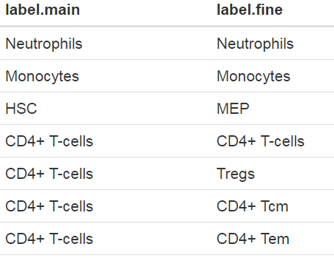
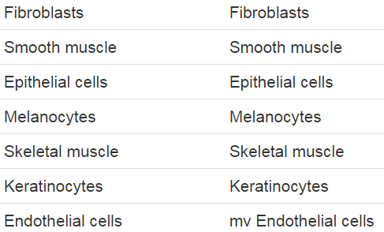
SingleR reference datasets

Slide 8
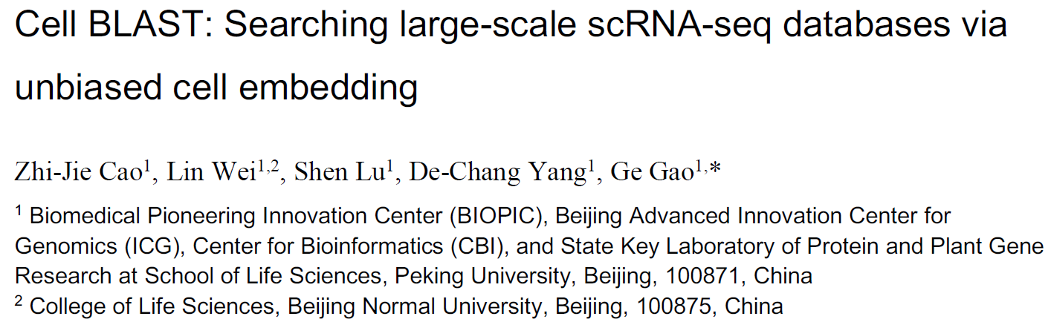

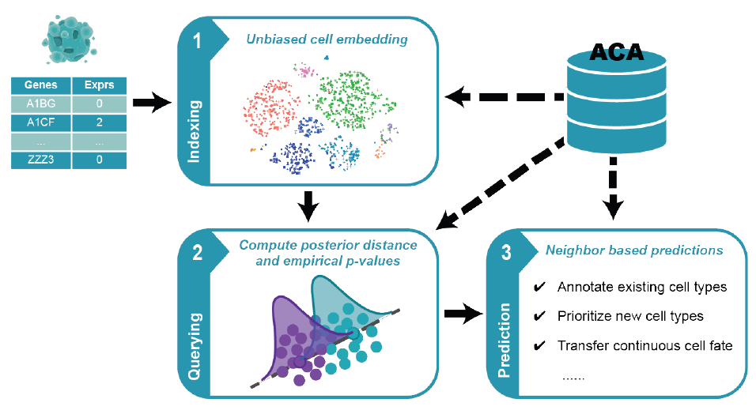
Cell BLAST
A new customized deep generative model together with a novel cell-to-cell similarity metric specifically designed for cell querying
Curated 391 single-cell RNAseq datasets with 986,305 cells in total, which covers 27 distinct organs across 8 species

Slide 9
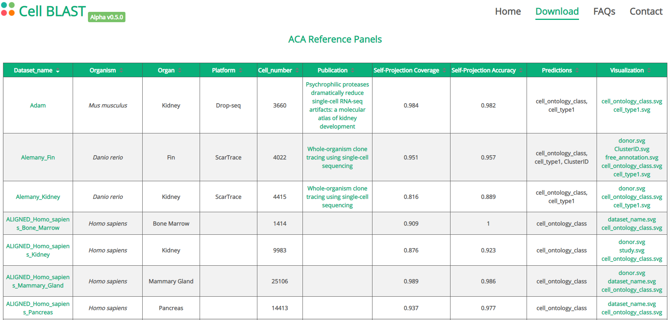
Cell BLAST reference datasets
Curated 391 single-cell RNAseq datasets with 986,305 cells in total, which covers 27 distinct organs across 8 species
All records in ACA are collected and processed using a standard procedure

Slide 10
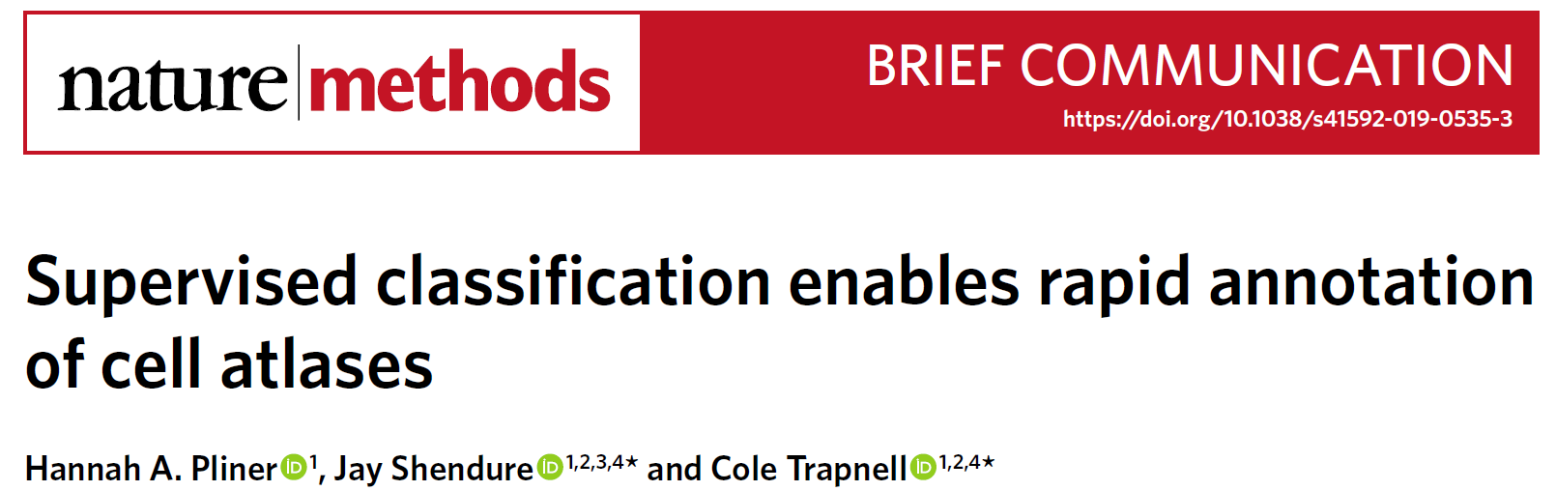
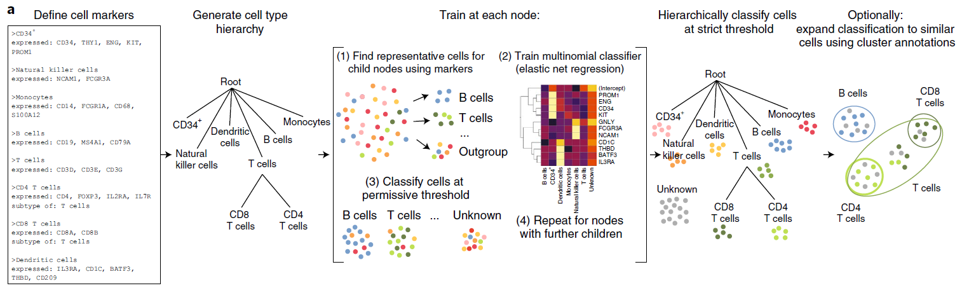
Garnett
Automates and standardizes the process of classifying cells based on marker genes
Doesn’t require pre-classified training datasets
Garnett uses a marker file to allow users to specify cell type definitions. These definitions are then used to choose representative cells from each cell type to train the classifier

Slide 11
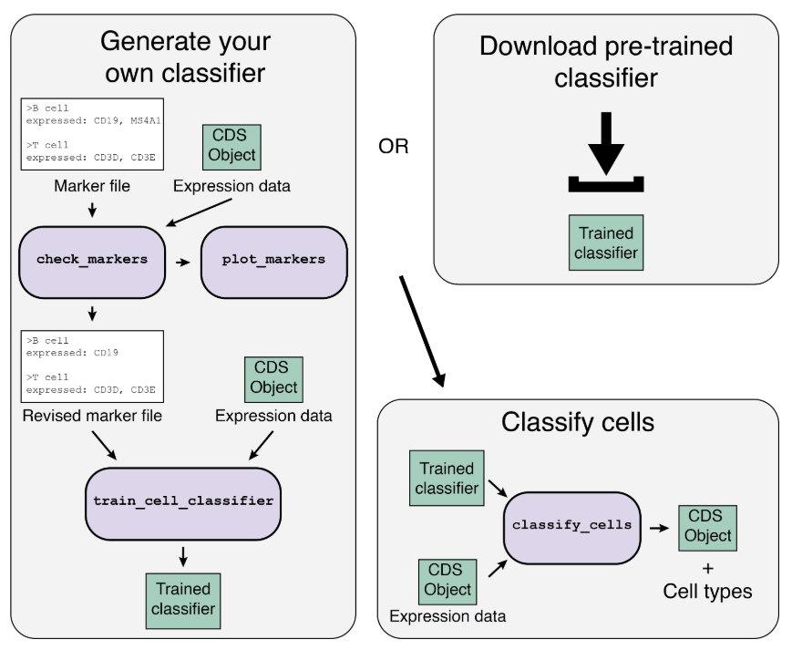
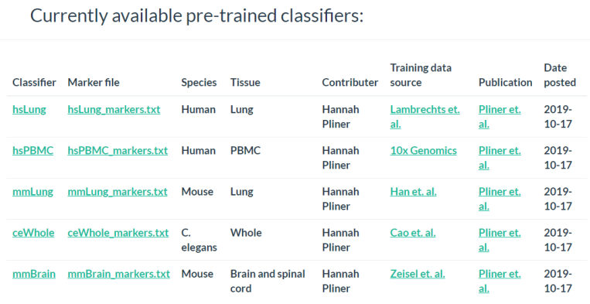
Garnett classifiers

Slide 12
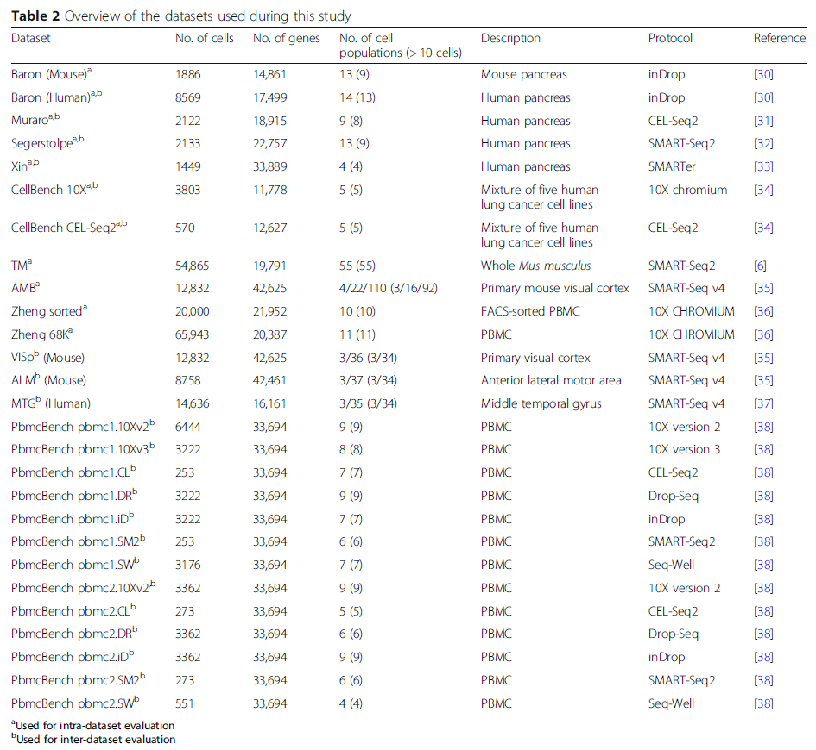
Overview of the single-cell RNAseq datasets
Number of cells:
Typical sized datasets: 1500~8500
Large datasets: > 50,000
Protocols:
10X Chromium
Drop-Seq
InDrop
CEL-Seq2
SMART-Seq2
Annotation levels:
Allen Mouse Brain (AMB) dataset:
3, 16, or 92 cell populations
Sorted populations:
CellBench dataset: Lung cancer cell lines
Zheng sorted dataset: PBMC
PBMC datasets:
Zheng sorted dataset
Zheng 68K dataset
PbmcBench dataset

Slide 13
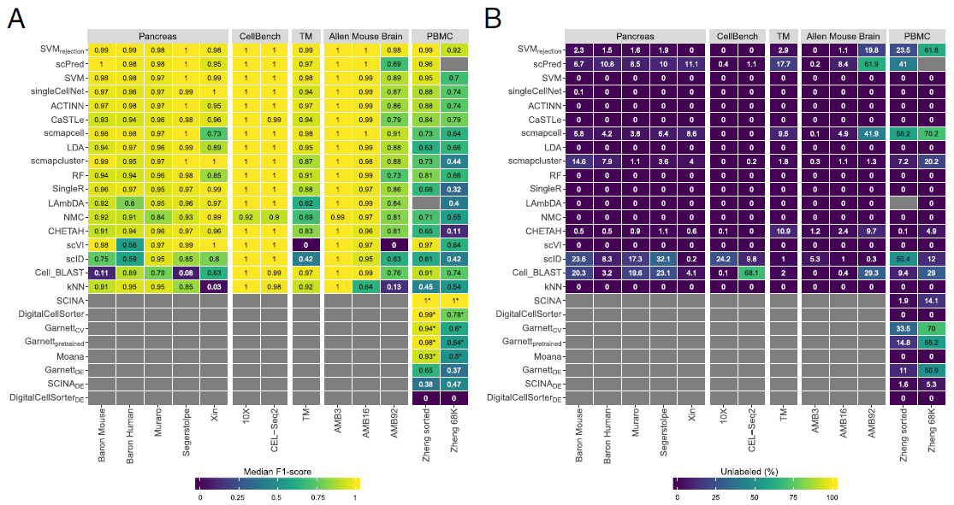
Performance evaluation within a dataset
F1 Score
Percentage of unlabeled cells
All classifiers perform well in the intra-dataset experiments with some exceptions (eg. Cell BLAST performs poorly for 2 pancreatic datasets; scVI doesn’t work on the deeply annotated datasets: TM [55 cell populations] and AMB92 [92 cell populations]); SVM is always in the top five list for all the datasets
For easy classification task, all the classifiers perform almost perfectly (eg., CellBench datasets: five sorted lung cancer cell lines that are quite separable; AMB3: three major brain cell types)
For complex datasets with overlapping classes or deep annotations, the performance of all the classifiers drops (eg., AMB16: slightly more challenging, the performance of some classifiers drops, especially KNN; AMB92: the performance of all the classifiers drops further)

Slide 14
Performance evaluation within a dataset
F1 Score
Percentage of unlabeled cells
All classifiers show relatively low performance on the PBMC datasets (contain 11 immune cell populations, which are harder to differentiate, particularly the T cell populations)
Many of the top classifiers for PBMC either have large proportion of unlabeled cells or can only predict a few cell populations (eg., SVM_{rejection} and scPred )
Some classifiers have relatively high performance with acceptable rejection rate on PBMC, including scVI, Cell BLAST, SVM, Garnett, and Moana

Slide 15
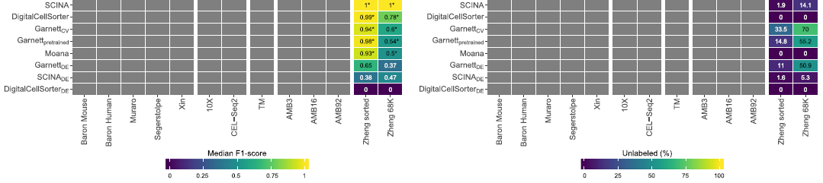
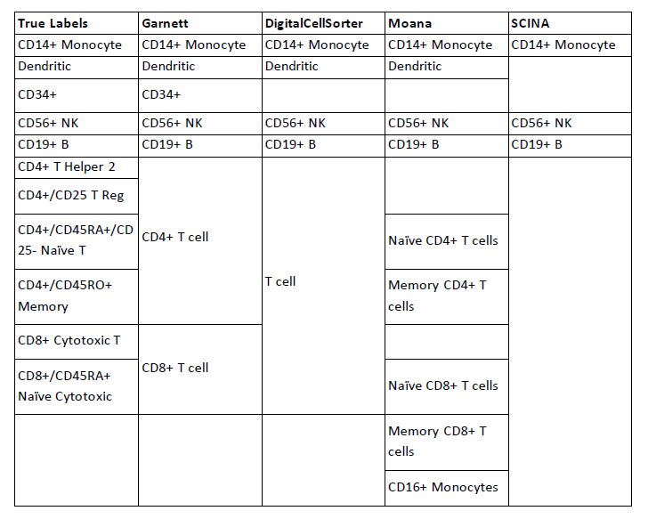
Pre-trained classifiers on PBMC

Slide 16
Performance evaluation within a dataset
F1 Score
Percentage of unlabeled cells
All classifiers show relatively low performance on the PBMC datasets (contain 11 immune cell populations, which are harder to differentiate, particularly the T cell populations)
Many of the top classifiers for PBMC either have large proportion of unlabeled cells or can only predict a few cell populations (eg., SVM_{rejection} and scPred )
Some classifiers have relatively high performance with acceptable rejection rate on PBMC, including scVI, Cell BLAST, SVM, Garnett, and Moana

Slide 17
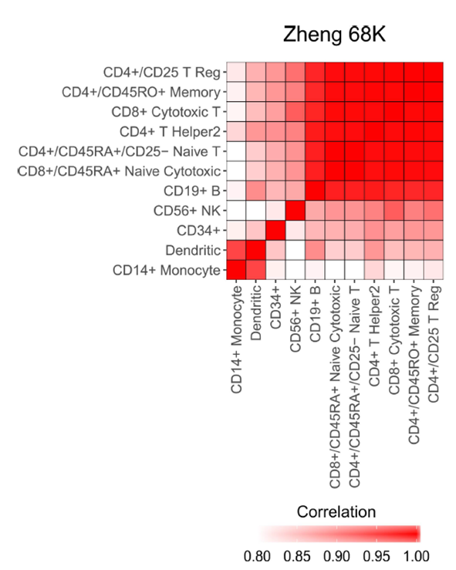
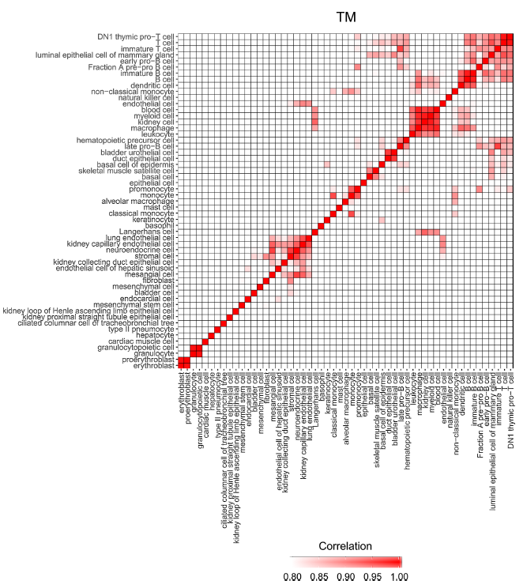
Classification performance depends on dataset complexity
Although TM and AMB92 have more cell populations (55 and 92, respectively) compared to Zheng 68K (11 populations), these populations are less correlated to one another, making the task easier for all the classifiers
Cells in the Zheng 68K dataset were annotated based on the correlation with cells in the Zheng sorted dataset

Slide 18
Performance evaluation across datasets
Classification performance across different protocols
PBMC datasets
pbmc1: 10X V2; 10X V3; CEL-Seq2; Drop-seq; InDrop; Smart-seq2; Seq-Well
pbmc2: 10X V2; CEL-Seq2; Drop-seq; InDrop; Smart-seq2; Seq-Well
Classification performance across different species
3 brain datasets: VISp and ATM (mouse); MTG (human)
Major lineage annotation with 3 cell populations
Deeper level of annotation with 34 cell populations
Classification performance across different protocols and different labs
4 human pancreatic datasets: Baron Human (InDrop), Muraro (CEL-Seq2), Segerstople (SMART-Seq2), and Xin (SMARTer)
Training on three datasets and test on one dataset
Original data
Aligned data using the mutual nearest neighbor (MNN) method
Notes:
VISp and ATM (mouse); MTG (human, single nucleus)
SMART-Seq v4

Slide 19
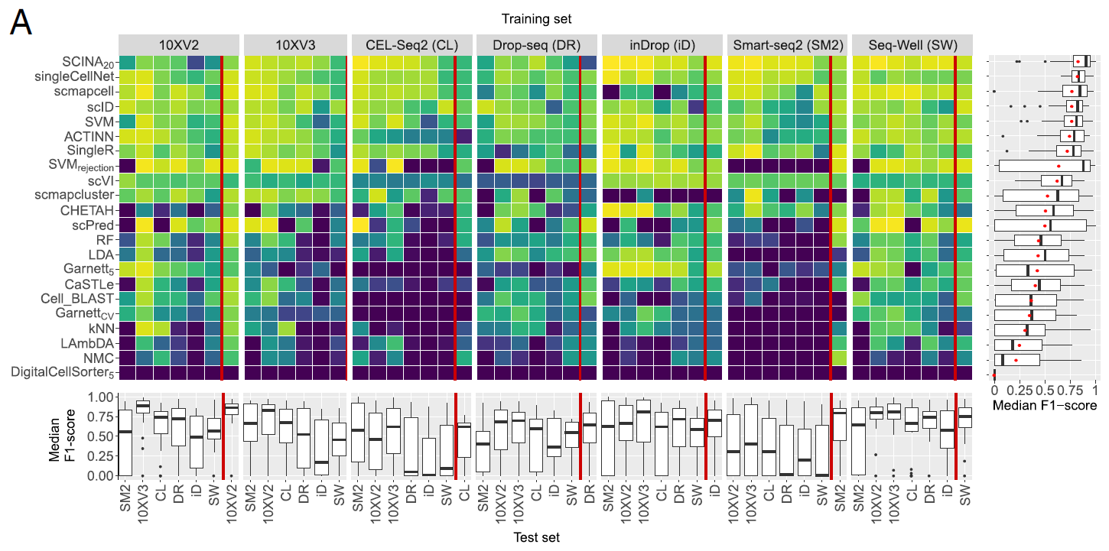

Classification performance across different protocols
Many classifiers have low performance when comparing across the different protocols
Several classifiers worked well, but not as good as in the intra-dataset experiment
singleCellNet (designed to make accurate classifications across platforms and species) and SVM are the top classifiers with high median F1 scores and low or no unassigned cells
All classifiers performed well when trained on 10Xv2 and tested on 10Xv3, and vice versa
The performance of all classifiers was low when they were either trained or tested on Smart-seq2 data (no UMI)

Slide 20
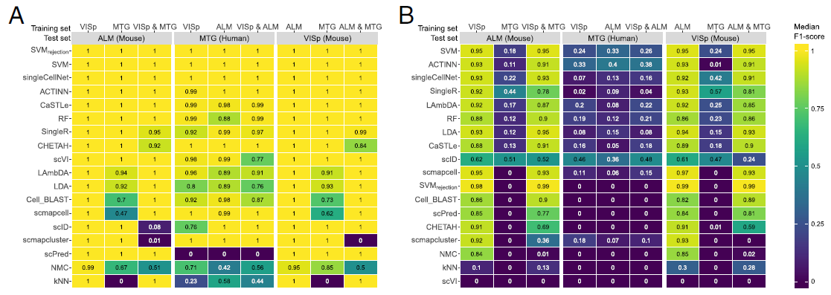
Classification performance across different species
AMB3
AMB34
For AMB3 with three major cell populations, all the classifiers performed almost perfectly when both the training and testing datasets were from the same species
Predicting the 34 cell populations in AMB34 dataset was more challenging, but almost all the classifiers also performed well within species
Train the model using a reference dataset from a species to predict cells from a different species didn’t work well, especially for deeply annotated datasets

Slide 21
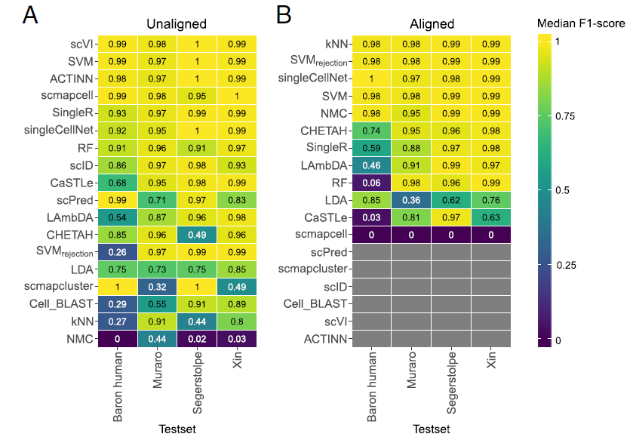
Classification performance across different protocols and different labs
Most classifiers performed good even the training and test datasets were from different labs using different protocols for the human pancreatic datasets. Could also be because the pancreatic datasets were easier for classification
Some classifiers benefit from aligning datasets such as SVM_{rejection}, kNN, NMC, and singleCellNet
Notes:
Some other classifiers failed to run over the aligned datasets (these classifiers work only with positive gene expression data, while the aligned datasets contain negative gene expression values)

Slide 22
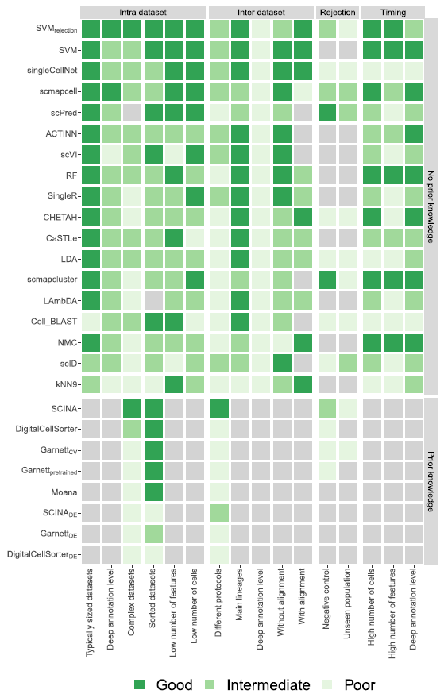
Summary
SVM/SVM_{rejection} classifiers have overall the best performance across the different experiments (need good training sets)
The performance of SingleR, Cell BLAST, and Garnett could be improved by using the built-in references or by providing a better definition of marker genes
It’s challenging for the annotation of complex datasets with overlapping classes or deep annotations, such as PBMC. SVM trained with a comprehensive training set, Cell BLAST, or Garnett with a better definition of marker genes would worth a try to solve the problem
singleCellNet has relatively high performance on PBMC dataset both for the intra-dataset experiment and for the comparisons across different protocols. Could also be a candidate for immune cell annotation
Notes:
based on random forest

Slide 24
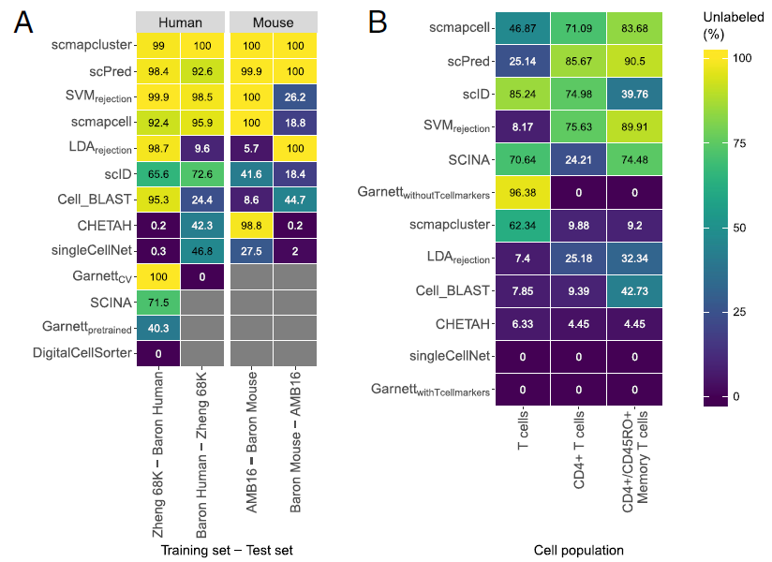
Rejection option evaluation

Slide 25
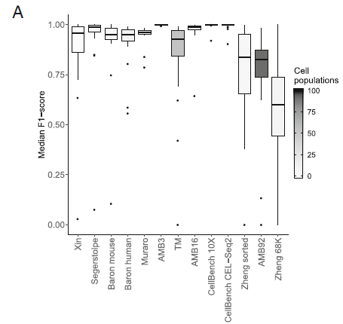
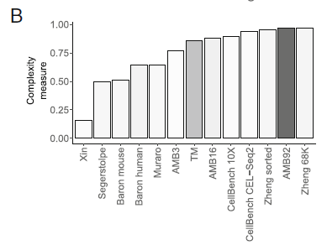
Classification performance depends on dataset complexity
Complexity: pairwise similarity between cell populations
When the complexity and/or the number of cell populations of the dataset increases, the performance generally decreases
Notes:
When the complexity and/or the number of cell populations of the dataset increases, the performance generally decreases
While both TM and AMB92 have more cell populations (55 and 92, respectively) compared to Zheng 68K (11 populations), these populations are less correlated to one another, making the task easier for all the classifiers

Slide 26
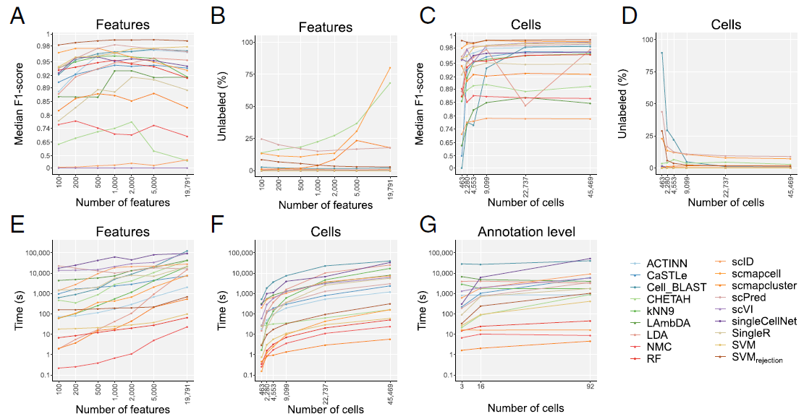

Slide 27
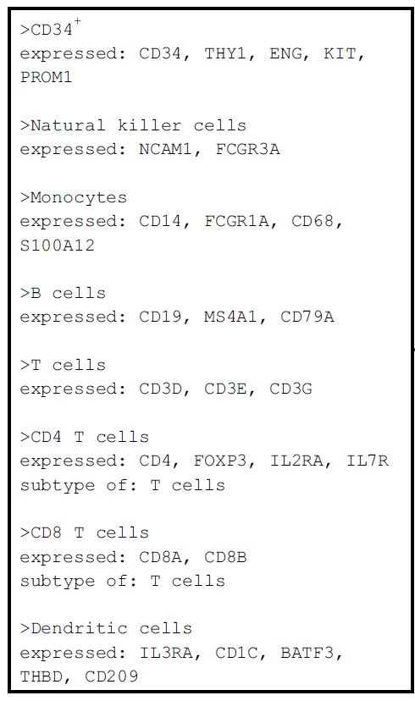

Slide 28
